Slide 1
WELCOME
DAY 5 :- 3 D PRINTING USING BAMBOO STUDIO

Slide 2
What is Bambu Studio?
Bambu Studio is a slicing software developed by Bambu Lab for preparing 3D models before printing. It converts 3D designs into instructions (G-code) that a 3D printer can understand and print layer by layer.
It is mainly used for:
Preparing 3D models for printing
Adjusting print settings
Slicing models into layers
Monitoring the printing process
Managing multiple colors and materials

Slide 3
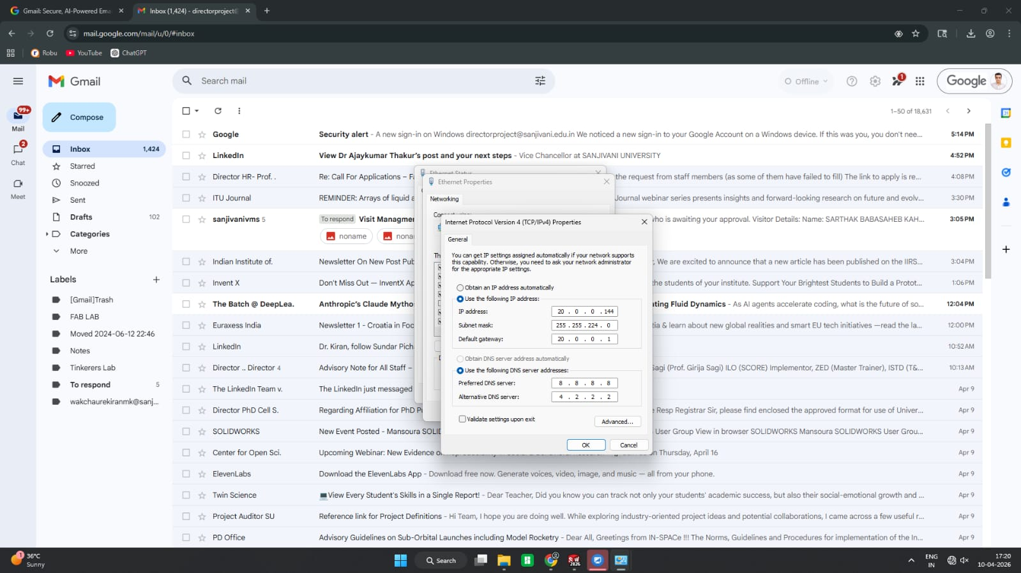
Install Bambu Studio
Open the official website: Bambu Studio
Download the software for your system:
Windows
Mac
Linux
Install the software by following the setup instructions.

Slide 4
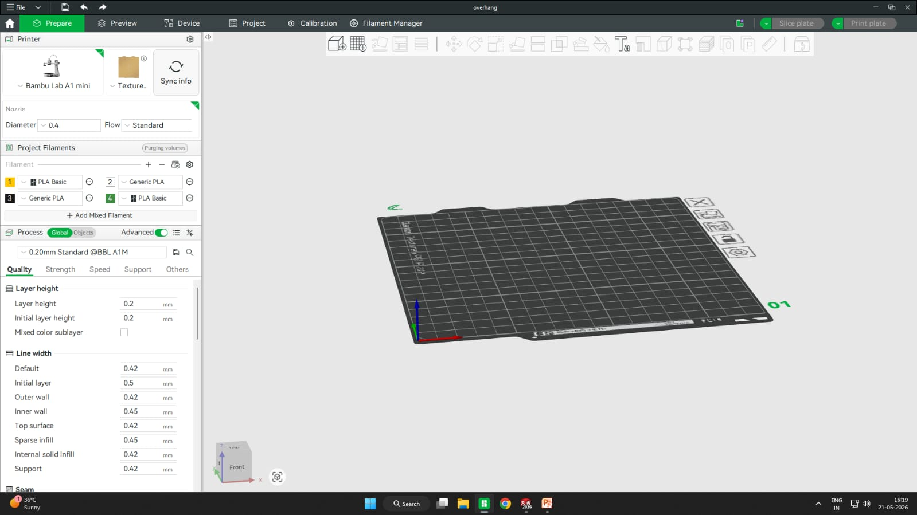
Open Bambu Studio
Launch Bambu Studio.
Sign in using your Bambu Lab account.
Connect your Bambu Lab printer to Wi-Fi.

Slide 5
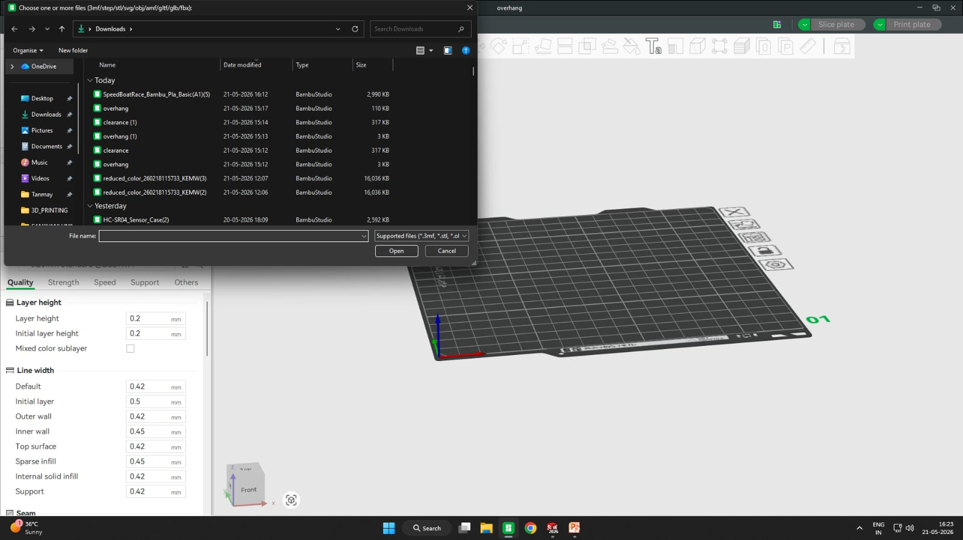
Add Your 3D Model
You can use files like:
.STL
.OBJ
.3MF
To import:
Click File → Import
Or drag and drop the model into the workspace.
Your 3D model will appear on the build plate.

Slide 6
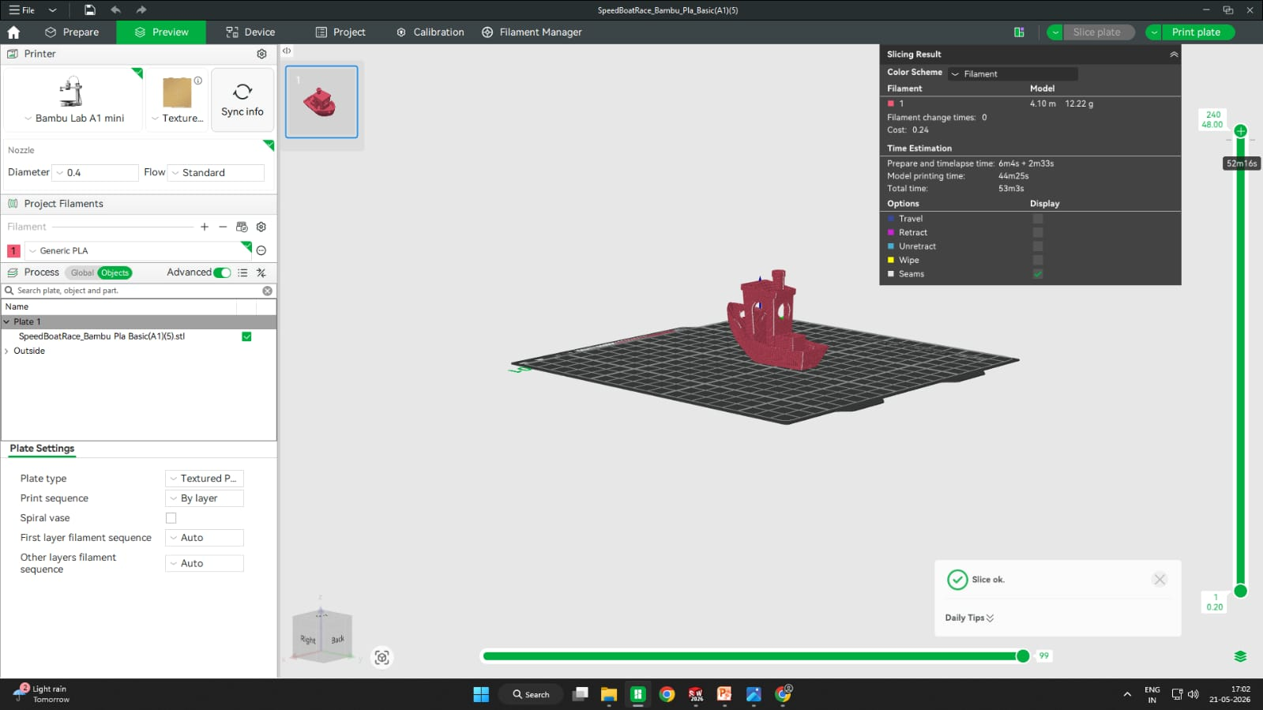
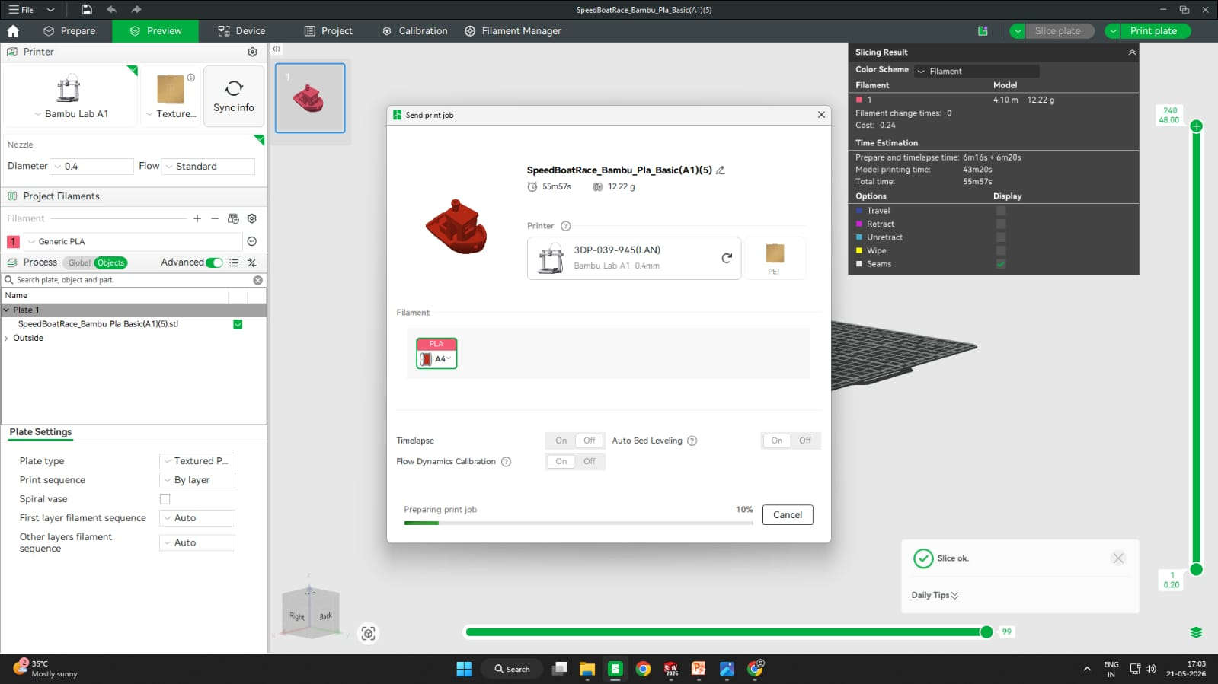
Select Your Printer
At the top left:
Choose your printer model:
X1 Carbon
P1S
A1 Mini
etc.
Select filament type:
PLA
PETG
ABS
TPU

Slide 7
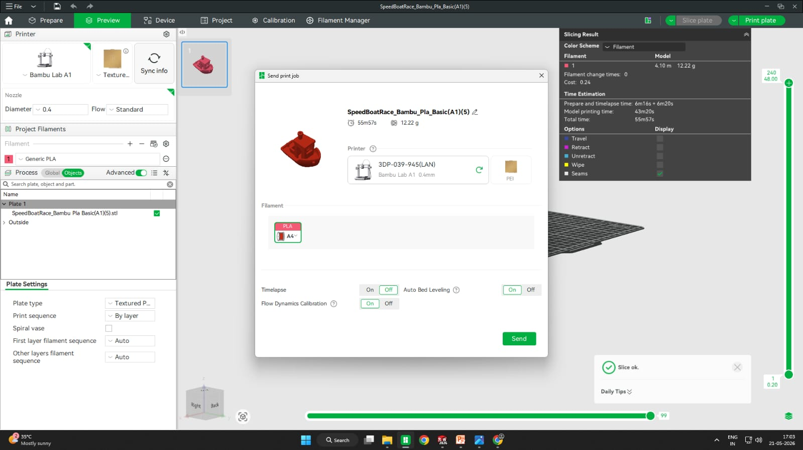
Send the File to Printer
Method 1 — Send via Wi-Fi
Make sure:
Printer and PC are
on same Wi-Fi
Printer is online
Click: Print Plate
Select:
Your printer
Filament slot
Click: Send Print
The printer will start printing automatically.

Slide 8
conclusion
Bambu Studio is easy and efficient for 3D printing.
It improves print quality and accuracy.
The software is user-friendly and reliable.
It supports easy printer control and monitoring.
Overall, it makes 3D printing faster and simpler.

